Slide 1
Machine Learning with Azure Machıne Learnıng Studio
ERHAN BALLIEKER
MCT

Slide 2
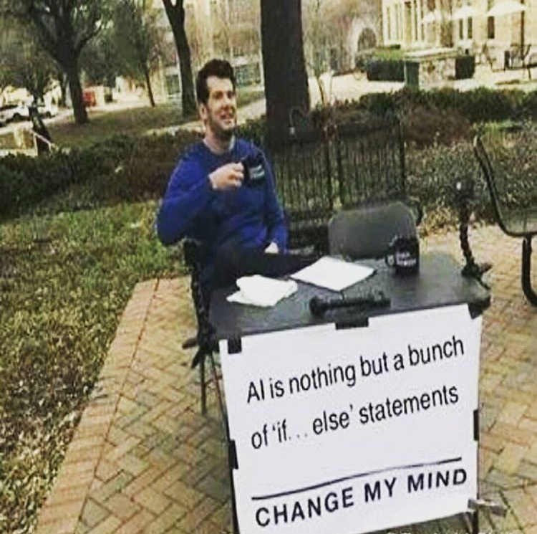

Slide 3
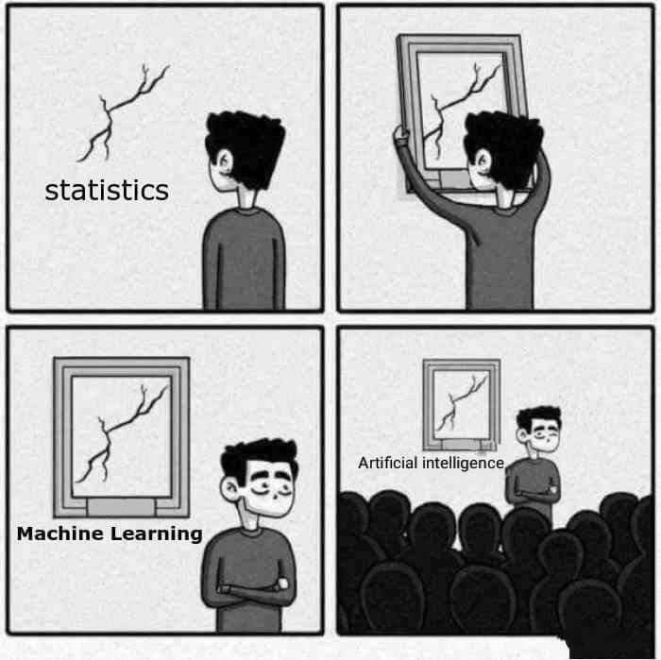
WHAT IS Machine Learning?

Slide 4
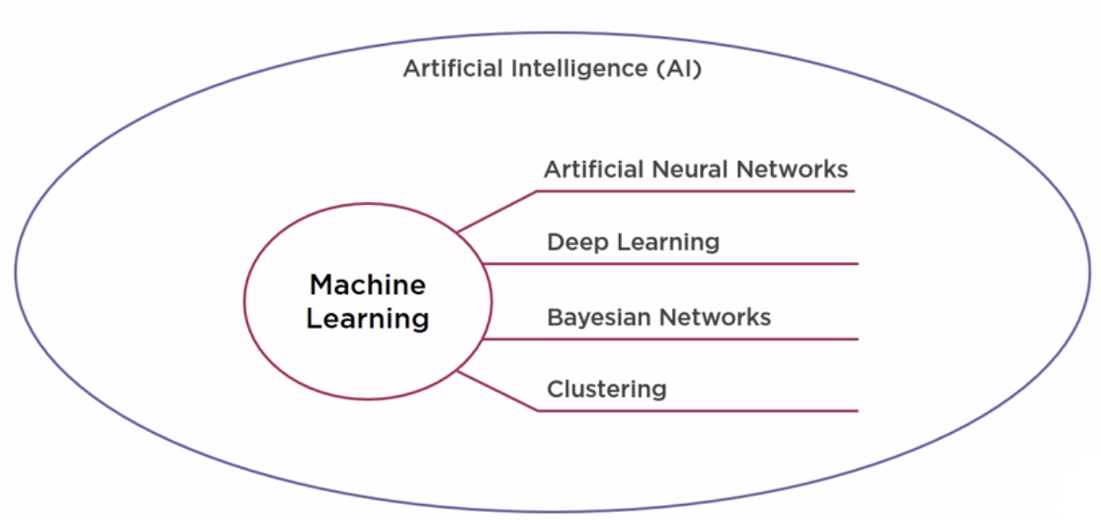

Slide 5
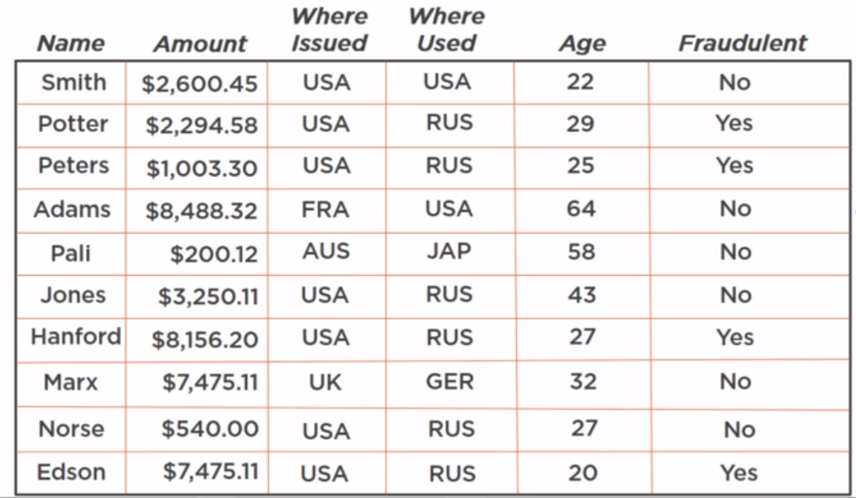

Slide 6
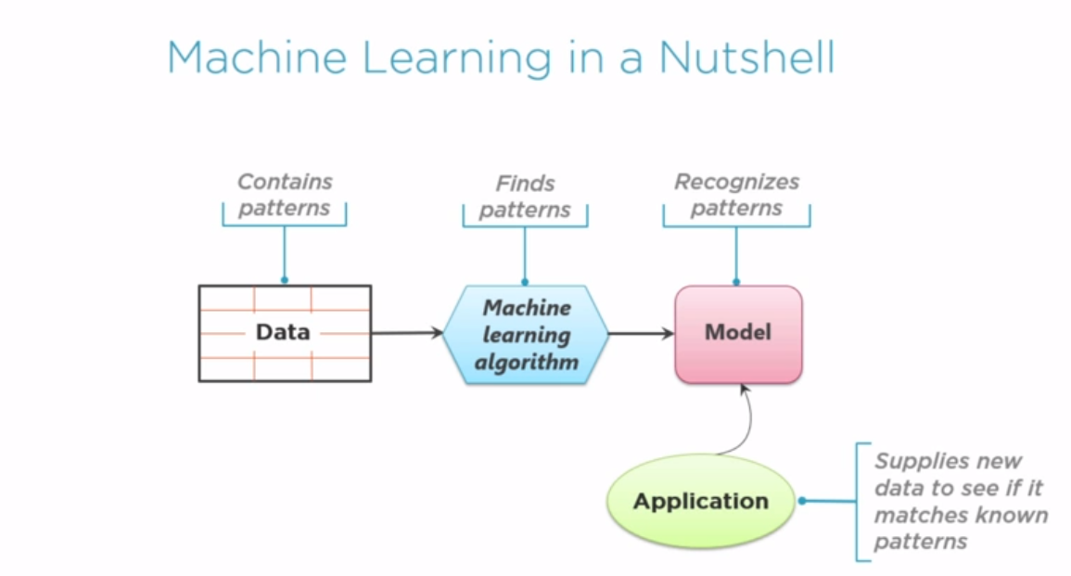

Slide 7
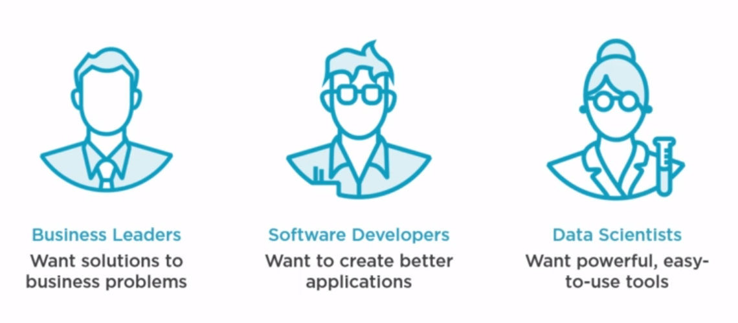

Slide 8
What is Data Scientist?
Statistics knowledge
Software programming knowledge
Domain expert in problem domain

Slide 9
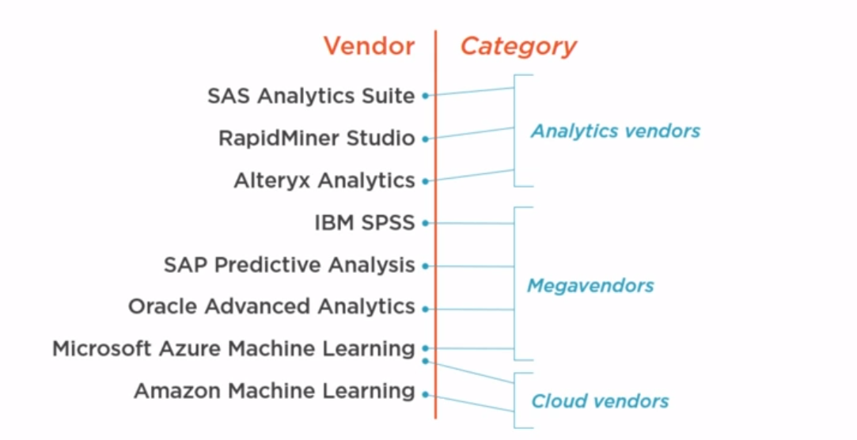

Slide 10
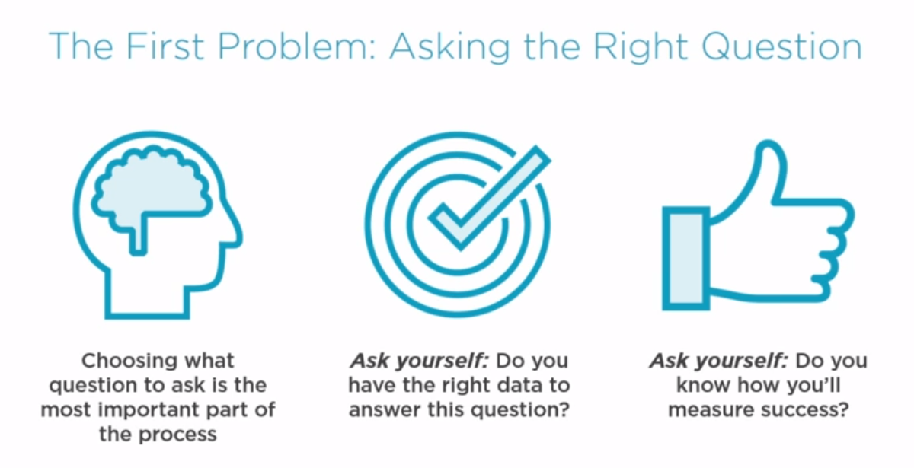

Slide 11
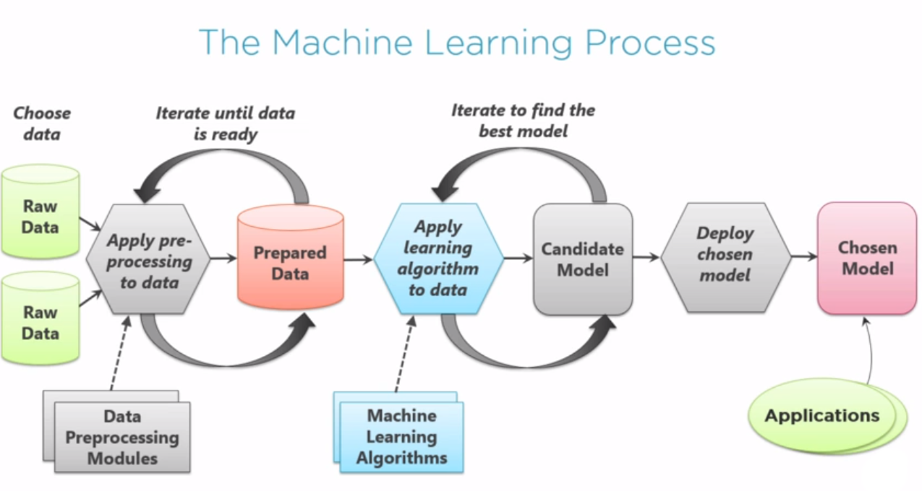

Slide 12
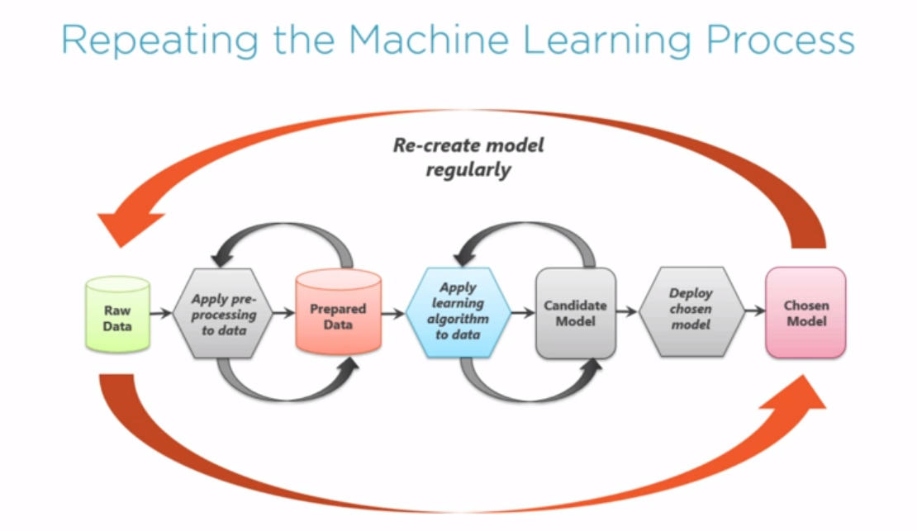

Slide 13
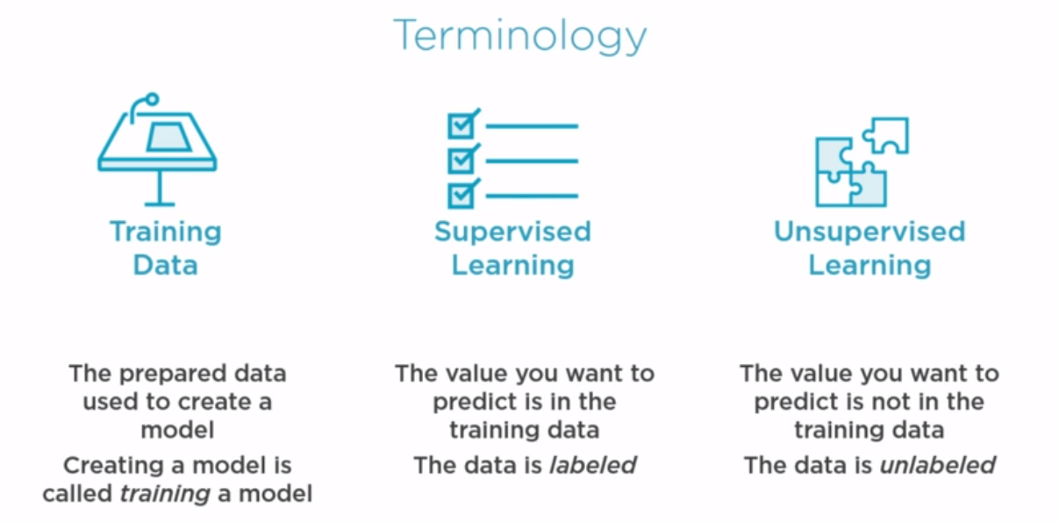

Slide 14
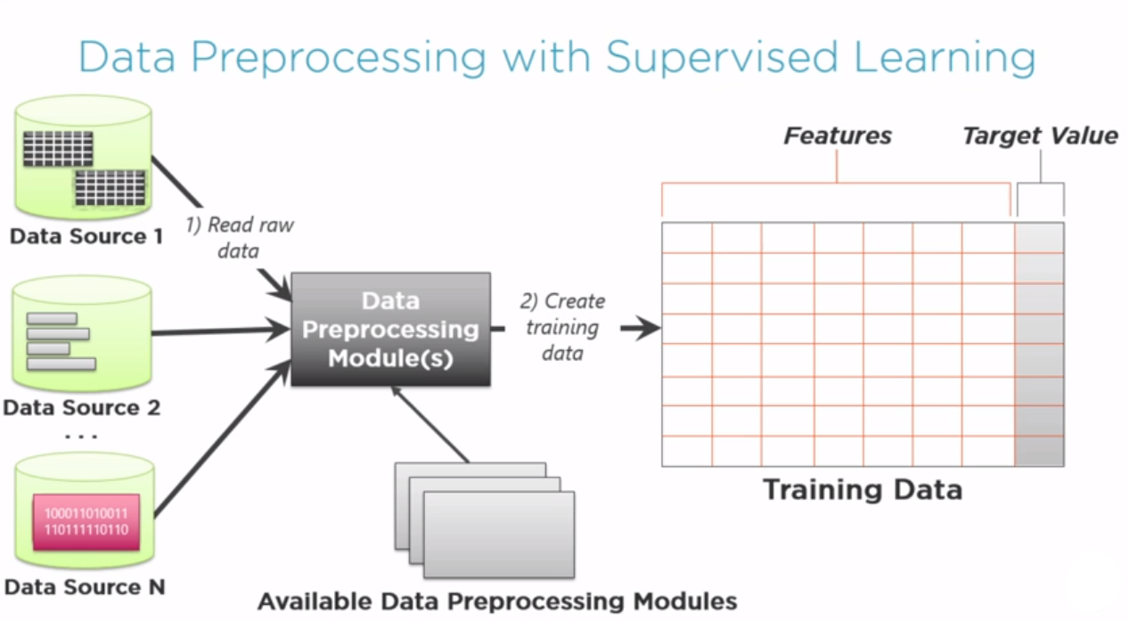

Slide 15
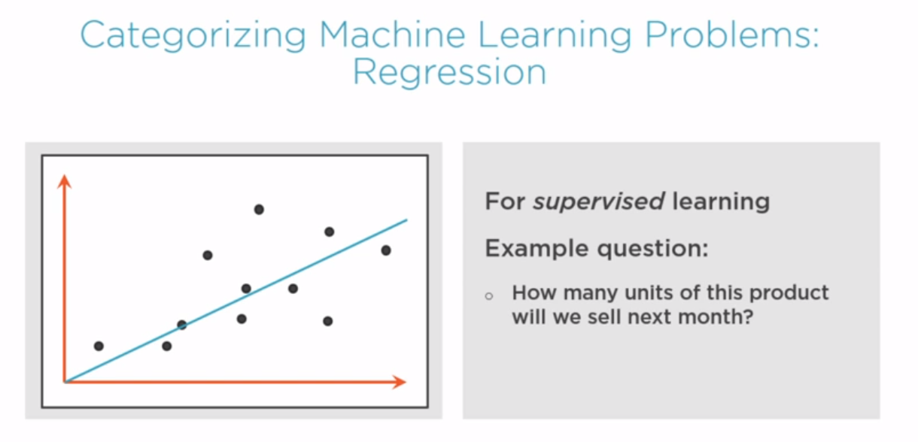

Slide 16
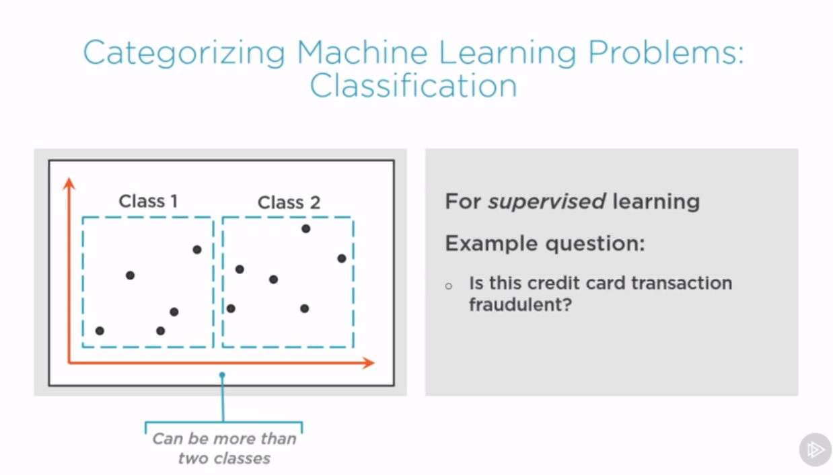

Slide 17
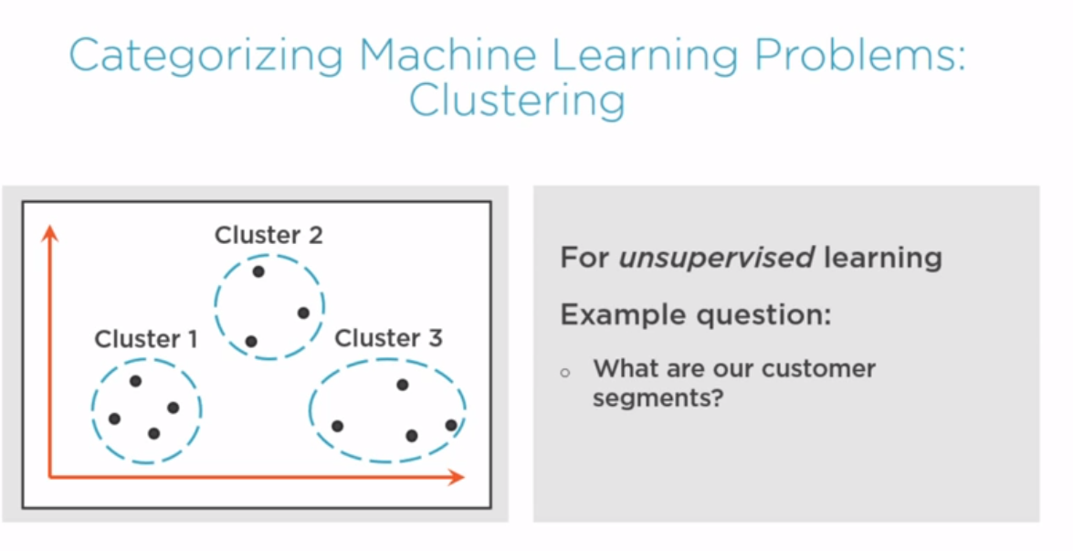

Slide 18
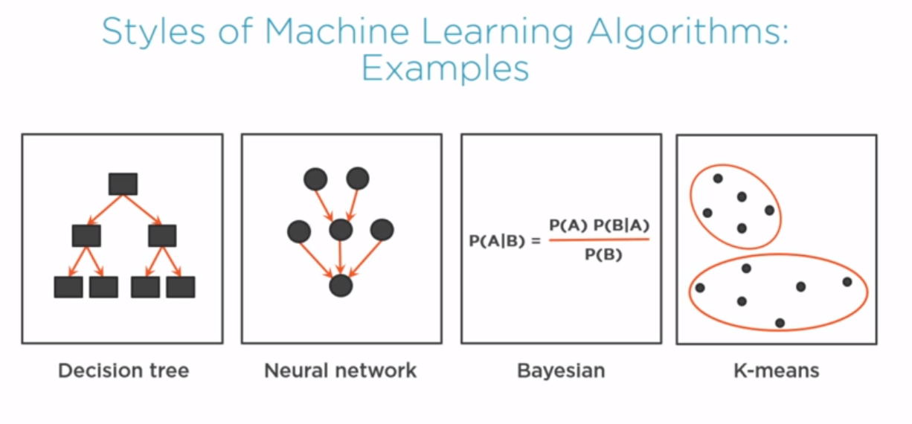

Slide 19
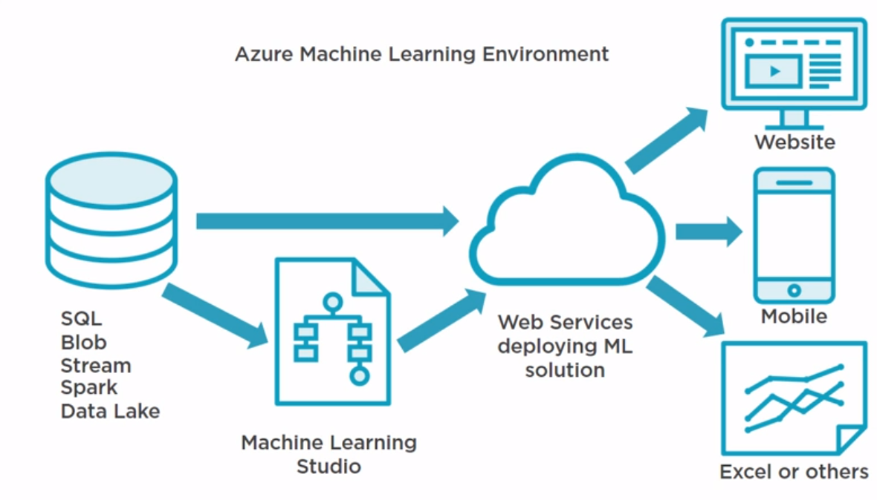

Slide 20
Data sets for ML traınıngs
http://archive.ics.uci.edu/ml/index.php
https://www.kaggle.com/datasets
https://www.openml.org/search?type=data

Slide 21
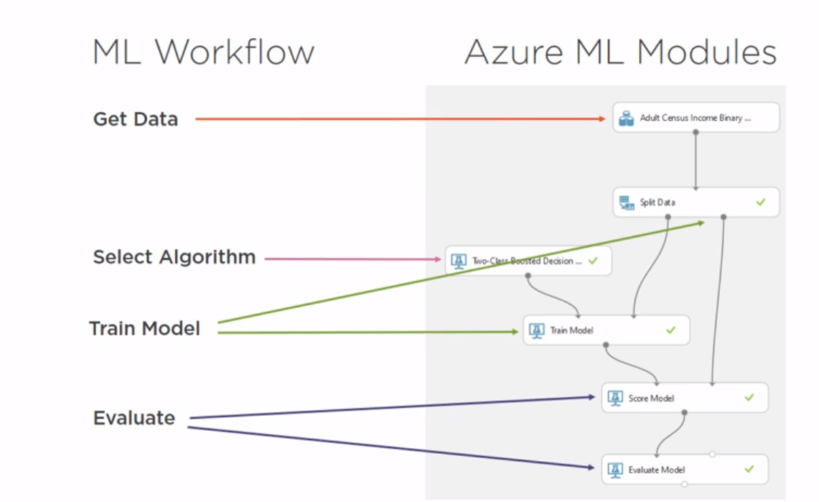

Slide 22
DEMO

